Slide 1

Week # 14
Operations Research
(Software Engineering)

Slide 2
Branch and Bound method
LPP
Infeasible or Unbounded
Integer Solution
Non-Integer Solution
Non-Integer Solution
A, Max Zu, Min ZL
Highest fractional value
B-ZL, Zu
Two Sub Problems B,C
OR
C-ZL , Zu
Highest or Lowest Integer soln-optimal
Integer soln=Zu, optimal
ZL<Sol <Zu
Sol <ZL, max or Sol>Zu, min
terminate
The procedure of branching and bounding continues until no further sub-problem
remains to be examined.

Slide 3
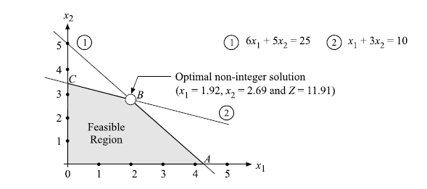
Solve the following all integer programming problem using the branch and bound method.
Maximize Z = 2x1 + 3x2
subject to the constraints
6x1 + 5x2 ≤ 25,
(ii) x1 + 3x2 ≤ 10
and x1, x2 ≥ 0 and integers.

Slide 4
Relaxing the integer conditions, the optimal non-integer solution to the given integer LP
problem obtained by graphical method x1 = 1.92, x2 = 2.69 and max Z1 = 11.91.
The value of Z1 represents initial upper bound as: Zu = 11.91. Since value of variable x2 is non-integer, therefore selecting it to decompose (branching) the given problem into two sub-problems by adding two new constraints x2 ≤ 2 and x2 ≥ 3 to the constraints of original LP problem as follows:
LP Sub-problem B Max Z = 2x1 + 3x2 (i) 6x1 + 5x2 ≤ 25, (ii) x1 + 3x2 ≤ 10, (iii) x2 ≤ 2, and x1, x2 ≥ 0 integers. | LP Sub-problem C Max Z = 2x1 + 3x2 (i) 6x1 + 5x2 ≤ 25, (ii) x1 + 3x2 ≤ 10 (iii) x2 ≥ 3, and x1, x2 ≥ 0 and integers.

Slide 5
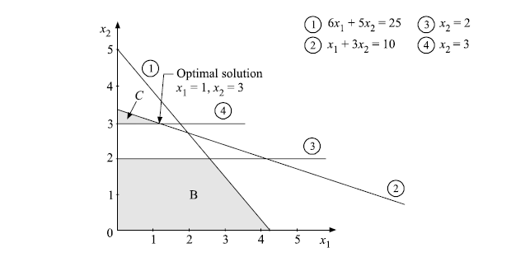
LP Sub-problem B Max Z = 2x1 + 3x2 (i) 6x1 + 5x2 ≤ 25, (ii) x1 + 3x2 ≤ 10, (iii) x2 ≤ 2, and x1, x2 ≥ 0 integers. | LP Sub-problem C Max Z = 2x1 + 3x2 (i) 6x1 + 5x2 ≤ 25, (ii) x1 + 3x2 ≤ 10 (iii) x2 ≥ 3, and x1, x2 ≥ 0 and integers.

Slide 6
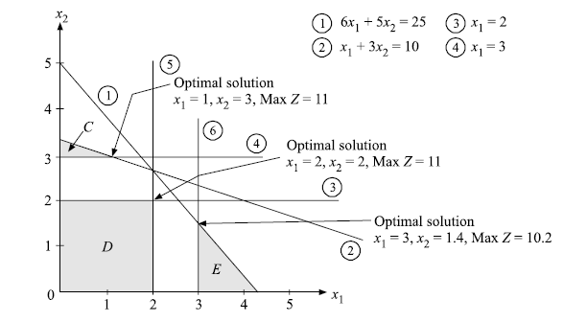
Sub-problem B : x1 = 2.5, x2 = 2 and Max Z2 = 11 Sub-problem C : x1 = 1, x2 = 3 and Max Z3 = 11 ZL = 11( Best integer solution value rounded off)
LP Sub-problem D LP Sub-problem E
Max Z = 2x1 + 3x2 Max Z = 2x1 + 3x2
subject to (i) 6x1 + 5x2 ≤ 25, subject to (i) 6x1 + 5z2 ≤ 25, (ii) x1 + 3x2 ≤ 10, (ii) x1 + 3x2 ≤ 10
(iii) x2 ≤ 2, (iii) x2 ≤ 2,
(iv) x1 ≤ 2 (iv) x1 ≥ 3
x1, x2 ≥ 0 and integers.
10

Slide 7
Sub-problem D : x1 = 2, x2 = 2 and max Z4 = 10
Sub-problem E : x1 = 3, x2 = 1.4 and max Z5 = 10.2
Values are less than ZL=11 so the process is terminated.

Slide 8
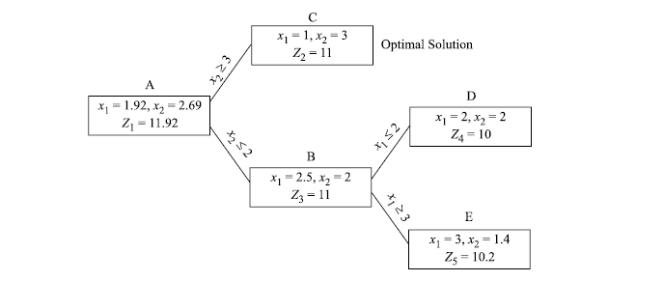

Slide 9
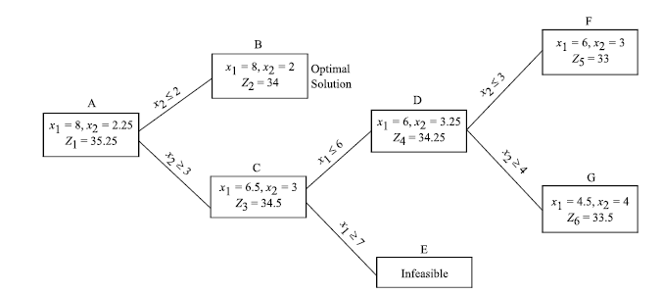
Example 2-Maximization Problem

Slide 10
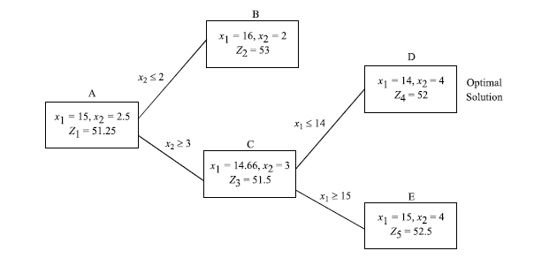
Example 3-minimization problem

Slide 11
Thank you!

